Slide 1

Engagement & Sentiment Analysis

Slide 2
Project Overview
Twitter at a Glance
Essential Question: How does a consumer’s interest, feelings towards, and engagement with a company correlate with its stock price?
Of the fortune 100 companies who has the most followers and by what industry?
Which companies have the highest search interest via google?
Which companies garner the most engagement through tweet volume and interactions?
Population of Interest: Publicly traded companies in the Fortune 100
Data sources: Twitter API (Followers, Favorites, Retweets, Sentiment), Alphavantage API (Closing Prices), Google API (Search volume Index)

Slide 3
Measuring our key variables
Engagement
Feelings
Twitter Retweets and Favorites per business day from Twitter API over a 30 day period.
Sentiment analysis of a sample of tweets that reference the name of the company over a 30 day period
Interest
Stock Price
Index of Google search volume per day over a 30 day period
Closing price for business day over a 30 day period

Slide 4
Gathering our key data
Engagement
Feelings
Tweepy package
Extracted most recent 3200 Tweets from the company
Recorded Counts of Favorites and Retweets
Removed Weekends
TwitterAPI Package
Extracted 100 Tweets per day for last 30 days
Cleaned tweet to remove symbols and links
Recorded polarity score for each tweet
Removed Weekends
Interest
Stock Price
Google Trends API
Extracted 0-100 index of popularity of searches for the company name
Removed Weekends
AlphavantageAPI
Limited to 30 days for regression testing

Slide 5
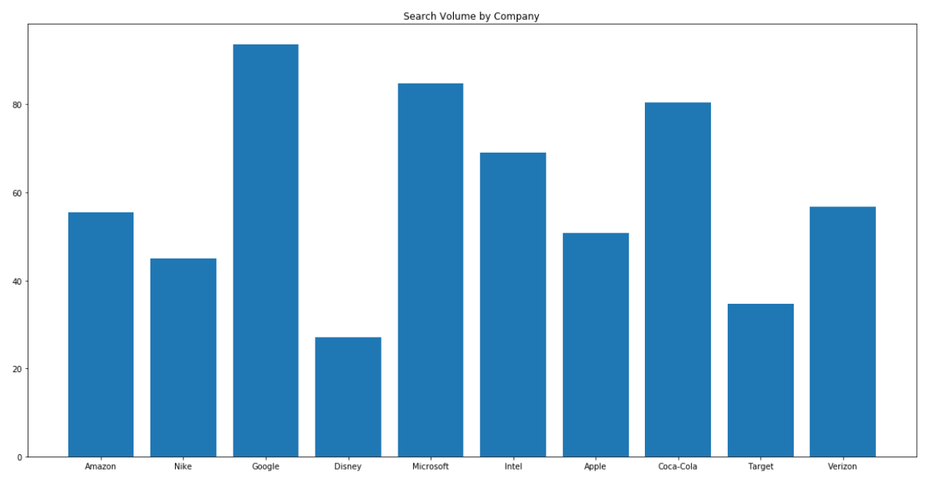
Search Volume by Company

Slide 6
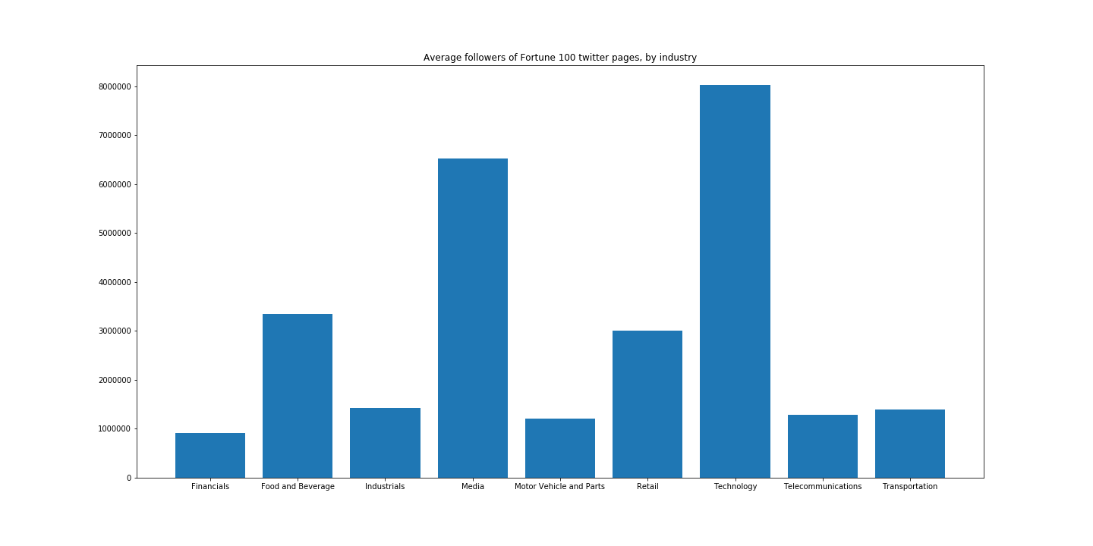
Most followers by industry, average

Slide 7
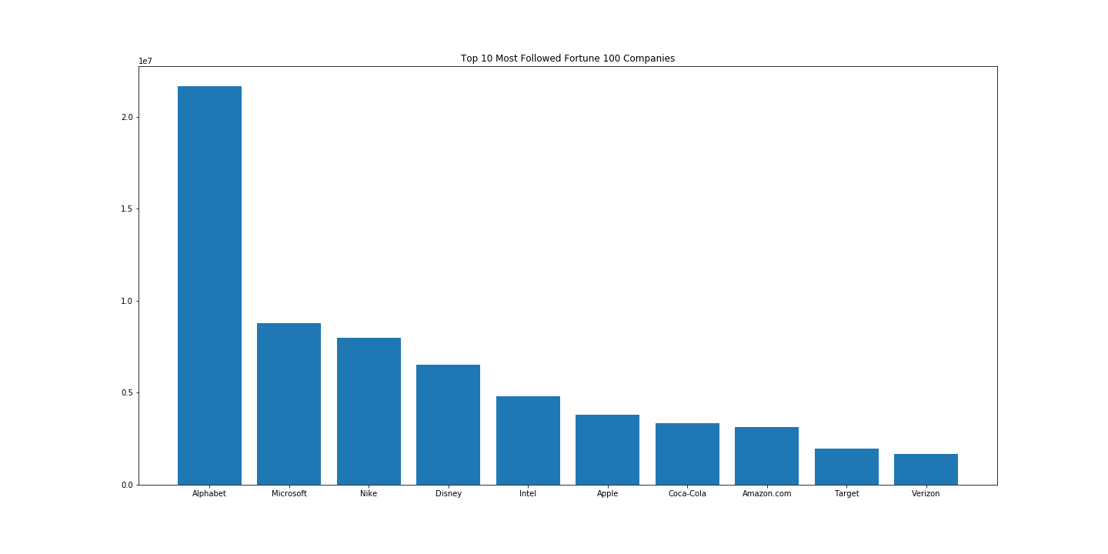
Top 10 Followed Companies
Most followers by industry, average

Slide 8
Regression Test
Dependent Variable: Closing price (Scaled)
Independent Variables: Lagged, scaled counts of Retweets, Favorites, Average Sentiment, and Search Volume
Questions we asked:
Can these metrics for feelings, engagement, and interest predict a stocks next-day closing price?
Are these variables significantly correlated with closing price?

Slide 9
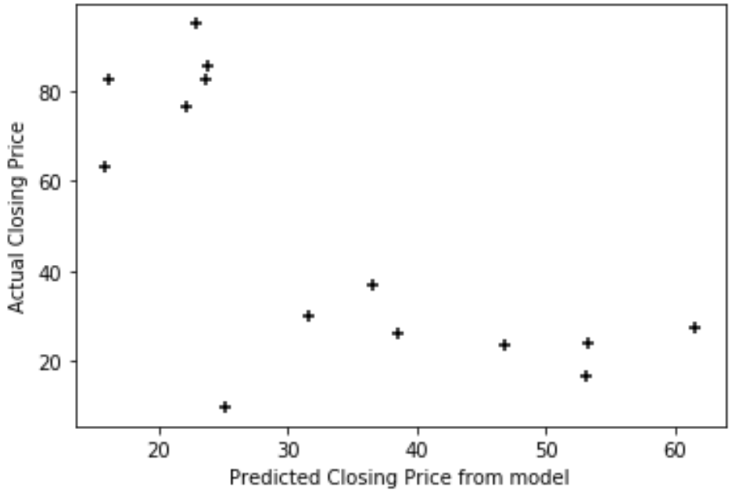
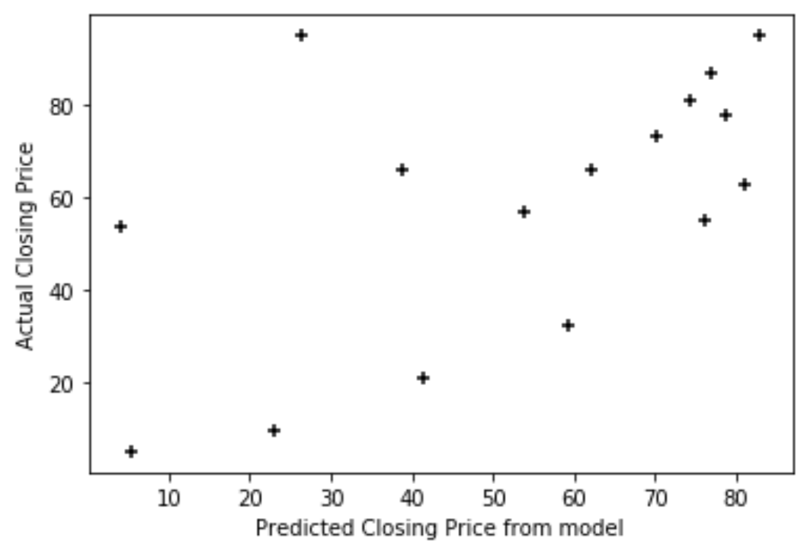
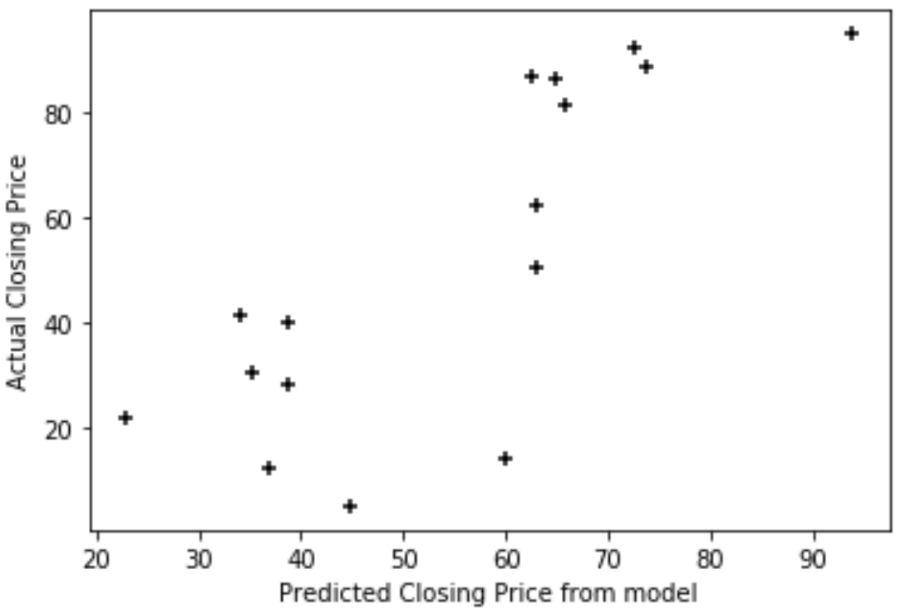
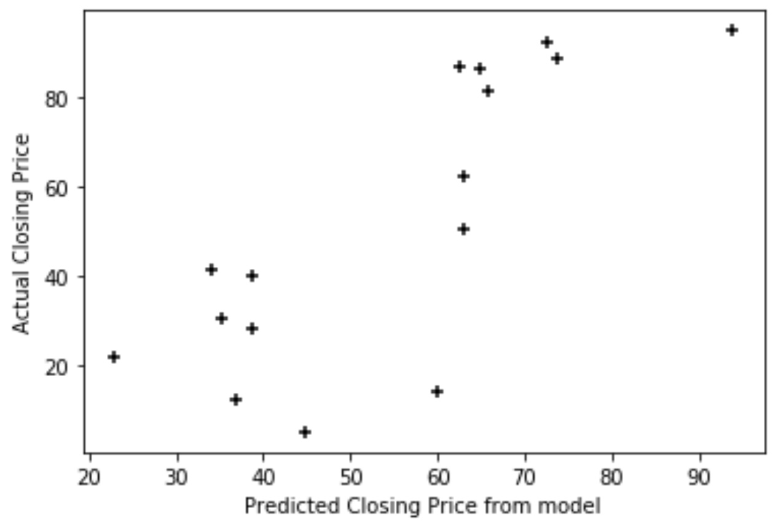
Predicted Closing vs Actual Closing for Most Followed Companies
Nike
Apple
Low R-squared (.35)
Disney
Google

Slide 10
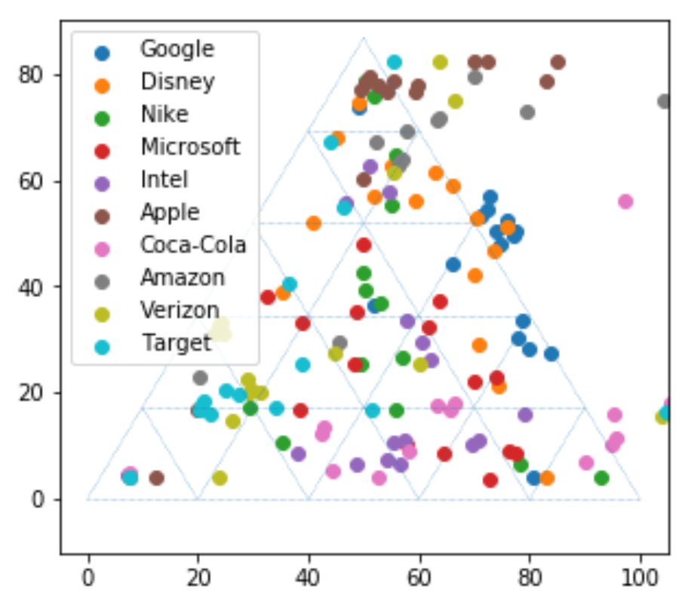
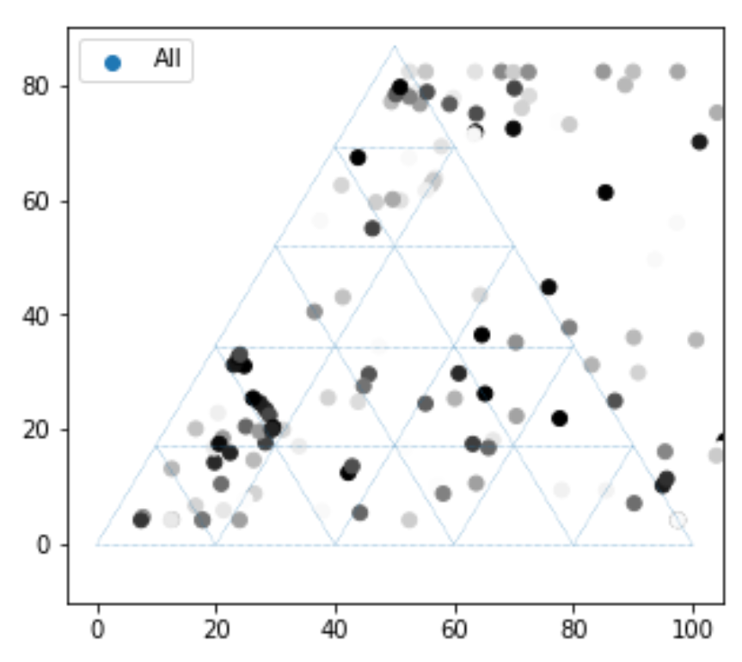
Ternary Diagram: Retweets, Sentiment, Search Volume
Retweets, Sentiment, Search Volume, by Company
Retweets, Sentiment, Search Volume, by Closing
Sentiment
Sentiment
Retweets
Searches
Retweets
Searches

Slide 11
Summary
Conclusion
Although we found some correlation for certain companies we did not find engagement and sentiment of a brand’s twitter account corresponds to the brands stock performance.
We were limited by the number of days back we could go for tweets and stock prices
Limited by the free api’s frequency restrictions
Questions?

